Slide 1
INTERNATIONAL STAFF WEEK 2024
Global Bridges and Green Visions: Erasmus+ Sustainability Dialogues
06th - 10th May 2024 - Sakarya University – Türkiye
How to Manage Project Grant Effectively
Prof. Dr. Samir AFIFI
International Relation - Projects Coordinator
Sakarya University - Türkiye
samirafifi@sakarya.edu.tr
Phone: +905317744935

Slide 2
INTERNATIONAL STAFF WEEK 2024
Global Bridges and Green Visions: Erasmus+ Sustainability Dialogues
International Relation - Sakarya University
What is Project Management
It is the application of:
Processes, Methods, Skills, Knowledge, Techniques and Experience to achieve “Specific project objectives
It should conduct according to project acceptance criteria within agreed parameters

Slide 3
INTERNATIONAL STAFF WEEK 2024
Global Bridges and Green Visions: Erasmus+ Sustainability Dialogues
International Relation - Sakarya University
Main five 5 stages of project management
Submitting Phase
1- Project Initiation.
2- Project Planning.
After Approval
3- Project Execution.
4- Project Monitoring and control (Quality Control and assurance).
5- Project Closure (Sustainability).

Slide 4
INTERNATIONAL STAFF WEEK 2024
Global Bridges and Green Visions: Erasmus+ Sustainability Dialogues
International Relation - Sakarya University
Project Management start with submitting new proposal
Project Management at Submitting Phase
1- Initiation.
2- Planning.
What should We know to start?
Points to consider when writing a proposal

Slide 5
INTERNATIONAL STAFF WEEK 2024
Global Bridges and Green Visions: Erasmus+ Sustainability Dialogues
International Relation - Sakarya University
1- Initiation!
Fund the right opportunity for your proposal
Shape your proposal based on action priorities and funding rules
Cross-check budget
Help with administrative documents

Slide 6
INTERNATIONAL STAFF WEEK 2024
Global Bridges and Green Visions: Erasmus+ Sustainability Dialogues
International Relation - Sakarya University
Right Opportunity:
KEY ACTION 2: Central Project
Main Objectives For CBHE
It shall address the advancement and challenges of HEIs located in eligible third countries not associated to the Program

Slide 7
INTERNATIONAL STAFF WEEK 2024
Global Bridges and Green Visions: Erasmus+ Sustainability Dialogues
International Relation - Sakarya University
Regions | Countries
Western Balkans (Region 1) | Albania, Bosnia and Herzegovina, Kosovo*, Montenegro
Neighbourhood East (Region 2) | Armenia, Azerbaijan, Georgia, Moldova, Ukraine*
South-Mediterranean countries (Region 3) | Algeria, Egypt, Israel*, Jordan, Lebanon, Libya, Morocco, Palestine*, Syria**, Tunisia
Asia (Region 5) | 5a Bangladesh, Bhutan, Cambodia, China, DPR Korea, India, Indonesia, Laos, Malaysia, Maldives, Mongolia, Myanmar, Nepal, Pakistan, Philippines, Sri Lanka, Thailand, Vietnam 5b High income countries: Brunei, Hong Kong, Japan, Republic of Korea, Macao, Singapore and Taiwan
Central Asia (Region 6) | Afghanistan, Kazakhstan, Kyrgyzstan, Tajikistan, Turkmenistan, Uzbekistan
Middle East (Region 7) | 7a Iran, Iraq, Yemen 7b High income countries: Bahrain, Kuwait, Oman, Qatar, Saudi Arabia, United Arab Emirates
Pacific (Region 8) | 8a Cook Islands, Fiji, Kiribati, Marshall Islands, Micronesia, Nauru, Niue, Palau, Papua New Guinea, Samoa, Solomon Islands, Timor-Leste, Tonga, Tuvalu, Vanuatu 8b High income countries: Australia, New Zealand
Sub-Saharan Africa (Region 9 ) | Angola, Benin, Botswana, Burkina Faso, Burundi, Cameroon, Cabo Verde, Central African Republic, Chad, Comoros, Congo, Congo - Democratic Republic of the, Côte d’Ivoire, Djibouti, Equatorial Guinea, Eritrea, Eswatini, Ethiopia, Gabon, Gambia, Ghana, Guinea, Guinea-Bissau, Kenya, Lesotho, Liberia, Madagascar, Malawi, Mali, Mauritania, Mauritius, Mozambique, Namibia, Niger, Nigeria, Rwanda, Sao Tome and Principe, Senegal, Seychelles, Sierra Leone, Somalia, South Africa, South Sudan, Sudan, Tanzania, Togo, Uganda, Zambia, Zimbabwe
Latin America (Region 10) | Argentina, Bolivia, Brazil, Chile, Colombia, Costa Rica, Ecuador, El Salvador, Guatemala, Honduras, Mexico, Nicaragua, Panama, Paraguay, Peru, Uruguay and Venezuela
Caribbean (Region 11) | Antigua & Barbuda, Bahamas, Barbados, Belize, Cuba, Dominica, Dominican Republic, Grenada, Guyana, Haiti, Jamaica, St Kitts and Nevis, St Lucia, St Vincent & Grenadines, Suriname, Trinidad & Tobago

Slide 8
INTERNATIONAL STAFF WEEK 2024
Global Bridges and Green Visions: Erasmus+ Sustainability Dialogues
International Relation - Sakarya University
2- Planning!
Find a Project idea
Choose appropriate and committed partners
Needs analysis
Develop logical framework
Formulate WPs and tasks
Points to be considered to manage writing a new proposal

Slide 9
INTERNATIONAL STAFF WEEK 2024
Global Bridges and Green Visions: Erasmus+ Sustainability Dialogues
International Relation - Sakarya University
2- Planning!
Ensure adequate human resources, time, and needed tools for project organization.
Committed management.
Make sure communication is planned and continuous
Points to be considered to manage writing a new proposal

Slide 10
INTERNATIONAL STAFF WEEK 2024
Global Bridges and Green Visions: Erasmus+ Sustainability Dialogues
International Relation - Sakarya University
As an applicant interested in CBHE, you should start with:
At first you need a concrete project idea in line with the CBHE objectives;
Define a Project Concept
Once the idea is defined, start locally in your institution consulting colleagues and departments with experience in international projects;
Find the right partners for establishing an international partnership based on trust and shared objectives;
Project consortium (National, Regional project, multiregional )
Project coordinator?
Project Partners?
Associated Partners?
At the end of this phase, Project is submitted

Slide 11
INTERNATIONAL STAFF WEEK 2024
Global Bridges and Green Visions: Erasmus+ Sustainability Dialogues
International Relation - Sakarya University
Project Management After Project Approval Implementing Phase
3- Execution.
4- Monitoring and control (Quality Control and Quality assurance).
5- Closure (Sustainability)

Slide 12
INTERNATIONAL STAFF WEEK 2024
Global Bridges and Green Visions: Erasmus+ Sustainability Dialogues
International Relation - Sakarya University
3- Execution
Organise kick-off meeting
Review project plan and revise if necessary
Take into account internal/external changes and limitations
Allocate roles according to work packages
Create project management structure (management board, other boards)
Set up communication rules
Revise budget allocation if necessary
Produce Partnership Agreement
Getting start
Points to be considered

Slide 13
INTERNATIONAL STAFF WEEK 2024
Global Bridges and Green Visions: Erasmus+ Sustainability Dialogues
International Relation - Sakarya University
4- Monitoring and control, QUALITY ASSURANCE
Keep partners
informed of the evaluation results and the remedial actions taken
Activities Monitoring
Internal Quality Assurance
External Quality Assurance

Slide 14
INTERNATIONAL STAFF WEEK 2024
Global Bridges and Green Visions: Erasmus+ Sustainability Dialogues
International Relation - Sakarya University
5- Closure (Sustainability)
Project results should be sustainable and should continue to be used /updated after end of project funding
Financial / administrative / legislative achievements
Continuation of developed programs
Continued cooperation with project partners
Student and staff mobility
Joint degrees
Research cooperation
New projects
Continued cooperation with
stakeholders at national/ regional cross regional levels

Slide 15
INTERNATIONAL STAFF WEEK 2024
Global Bridges and Green Visions: Erasmus+ Sustainability Dialogues
International Relation - Sakarya University
Good Communication, Dissemination and Exploitation
Ensuring Sustainability

Slide 16
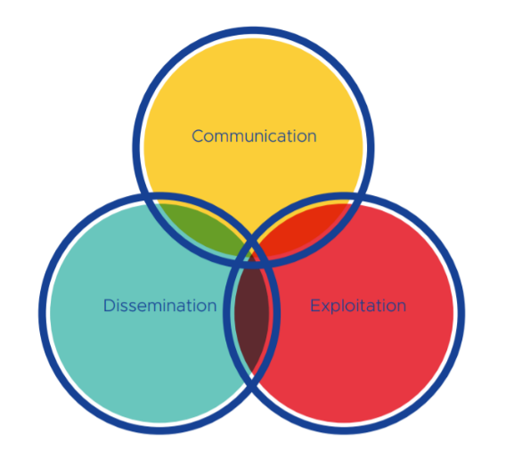
INTERNATIONAL STAFF WEEK 2024
Global Bridges and Green Visions: Erasmus+ Sustainability Dialogues
International Relation - Sakarya University
Communication Dissemination and Exploitation

Slide 17
INTERNATIONAL STAFF WEEK 2024
Global Bridges and Green Visions: Erasmus+ Sustainability Dialogues
International Relation - Sakarya University

Slide 18
