Slide 1
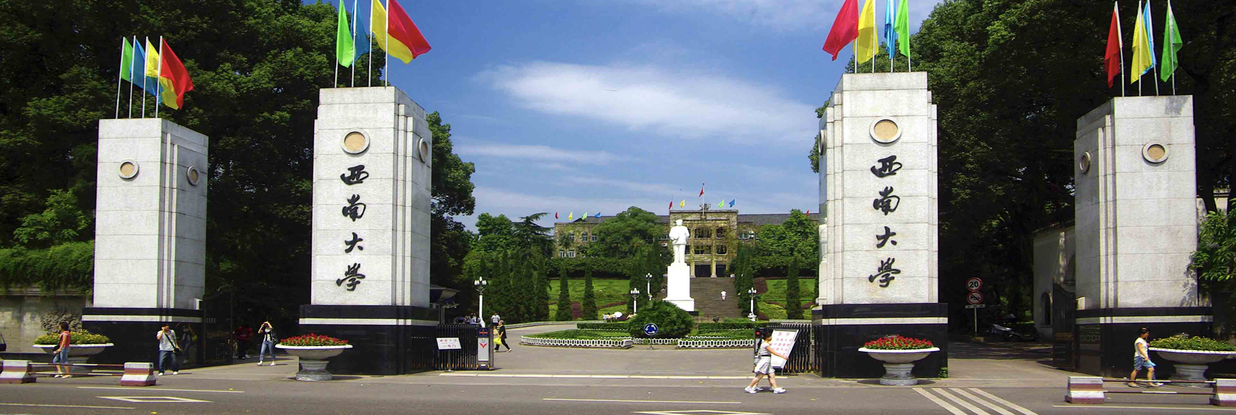
Promoting Sustainable
Development Goals through
International Cooperation:
Harnessing Global Collaboration for a Better Future
Prof. & Dr. Jiali Yao Southwest University, China
Email： 419629499@qq.com

Slide 2
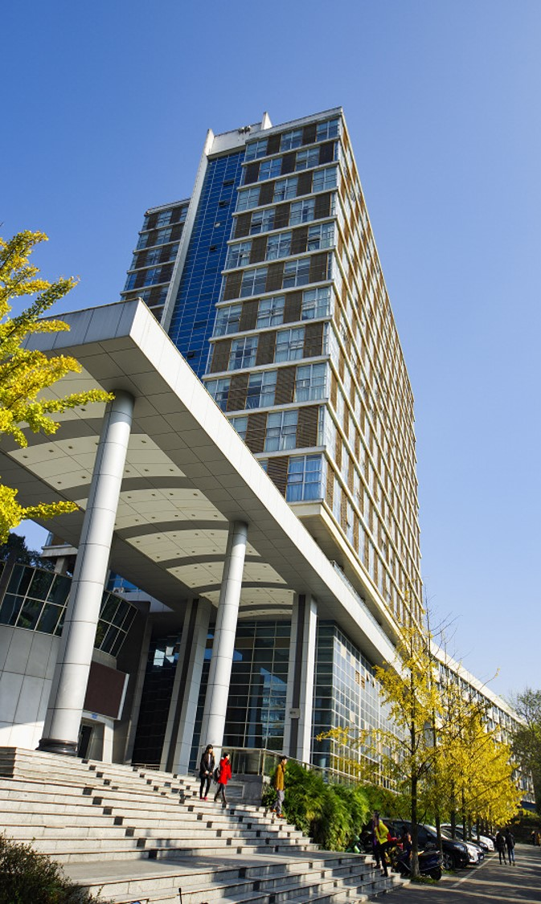
1.Sustainable Development Goals (SDGs) in China
2. How international cooperation contribute to achieving SDGs
3. The Practices for contributing SDGs at University Level

Slide 3
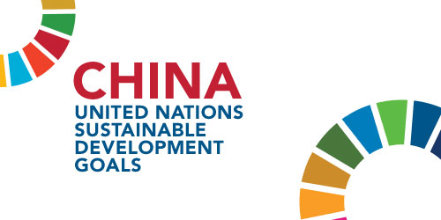
1.Sustainable Development Goals (SDGs) in China
The United Nations adopted 2030 Sustainable Development Goals in 2015, which is the most significant consensus reached by the international community, centering on poverty alleviation, green energy, healthcare improvement and other development goals. As a member of the UN, China has in the past years made steady progress to achieving the SDGs.

Slide 4
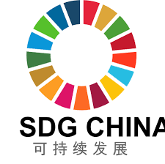
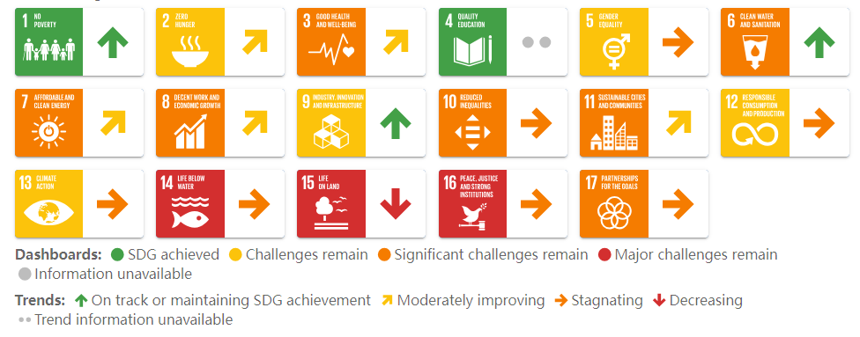
1.Sustainable Development Goals (SDGs) in China
China's central government integrated the sustainable development goals into the country's national development policy, including the 14th Five-Year Plan (2021-2025). It has also set up an interagency coordination system and constantly released position papers and progress reports on the SDGs.

Slide 5

2. How international cooperation contribute to achieving SDGs
Higher education institutions (HEIs) are a crucial pillar of the pursuit of the SDGs. They provide the knowledge, skills and mindsets essential for solving the world's sustainable development challenges and the meeting the SDGs.
The urgency of the situation demands that all sectors of society galvanize to secure greater participation and leadership, more resources and improved, game-changing solutions to address increasing inequality and the escalating climate emergency.
The SDGs are integrated into research programmes, national and international policies and even election campaigns globally. This is where universities and other HEIs can have serious impact.

Slide 6
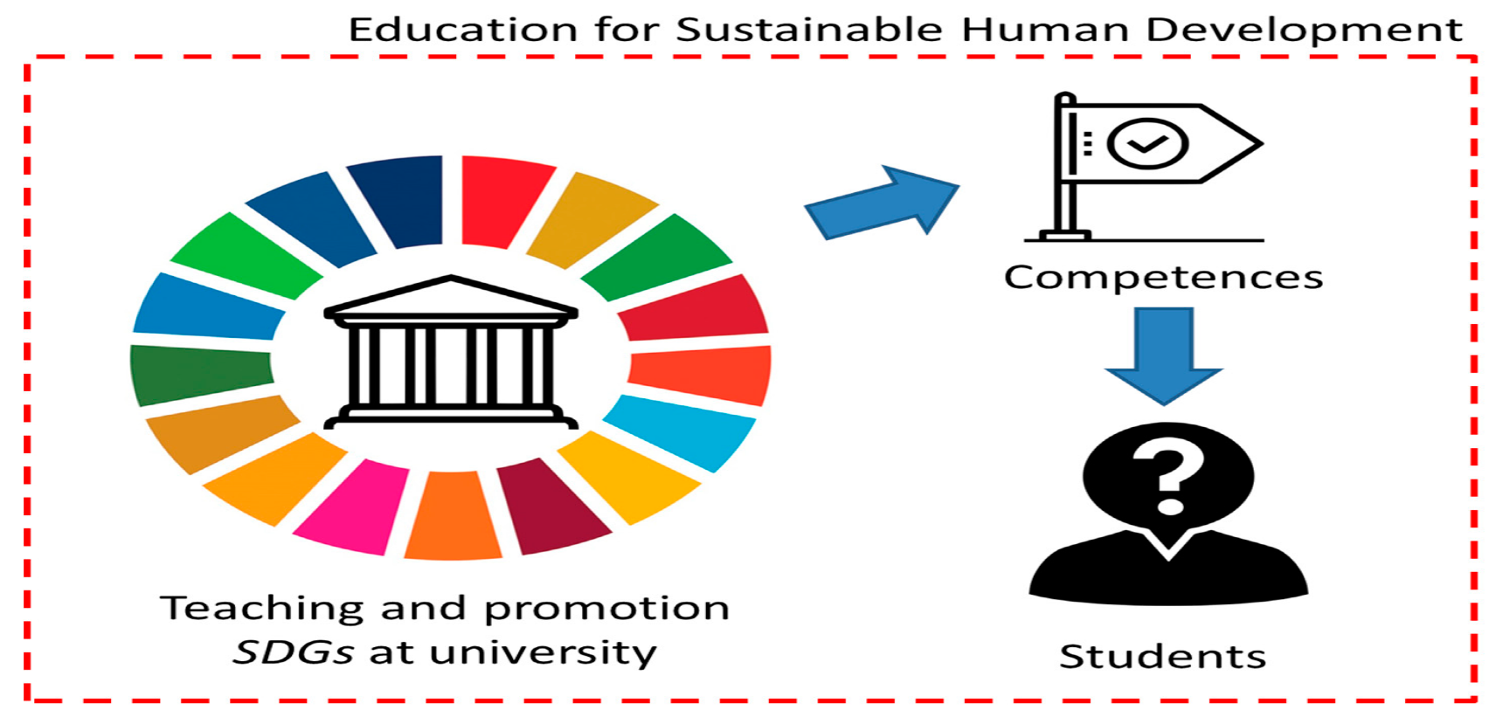

3. The Practices for contributing SDGs at University Level
Southwest University (SWU) develops the Practices for contributing SDGs, HEIs can contribute to the SDGs in various ways, leveraging their obvious strengths like education and research, but also their capacity to build communities, to influence people and to engage communities directly.

Slide 7
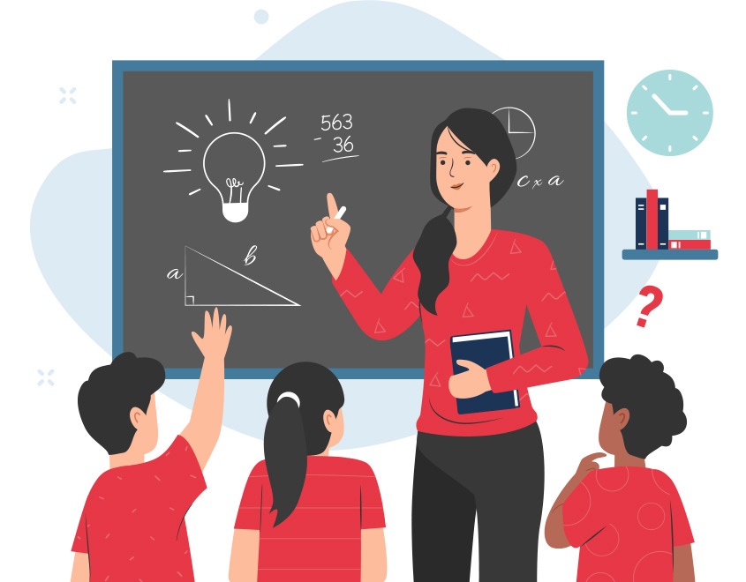
3. The Practices for contributing SDGs at University Level
3.1 Teaching
SWU incorporates elements of education for the SDGs into most existing formal and informal learning and teaching activities in universities. SWU also provide students with the necessary skills needed to implement the SDGs, such as strategic vision, design-thinking, social responsibility, problem-solving, anticipatory skills and interdisciplinary collaboration.

Slide 8
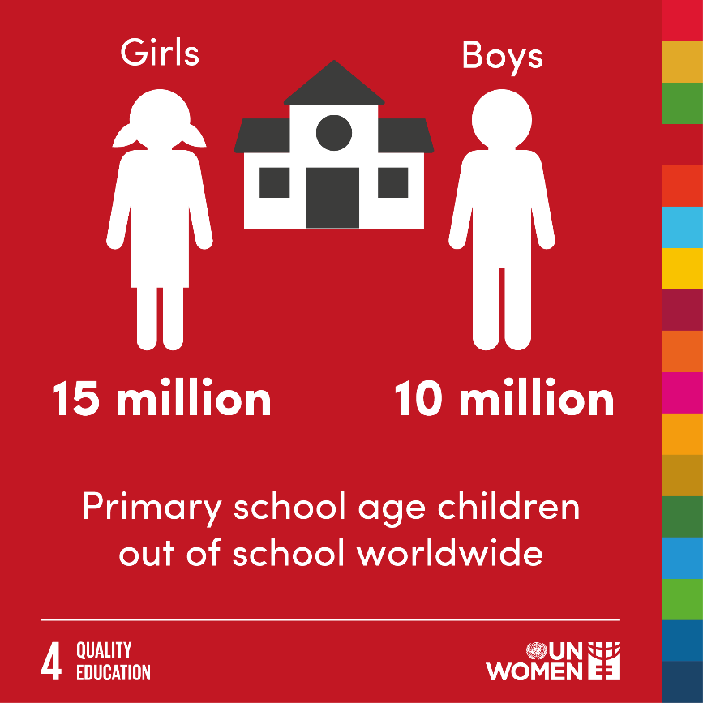

3. The Practices for contributing SDGs at University Level
3.2 Research
SWU provides cutting-edge academic knowledge in both research and teaching and stand as neutral and reliable stakeholders in society. HEIs can also contribute to identifying gender equality gaps in society and fight against sexual violence, abuse and harassment within their campuses with proactive policies.
Erasmus+ CBHE project: Promoting inclusive education through curriculum development and teacher education in China
Project No. 561600-EPP-2015-CN-EPPKA2-CBHE-JP

Slide 9
3. The Practices for contributing SDGs at University Level
3.3 Community engagement and Non-academic services
SWU engages with the local communities and contributes to society's progress towards gender equality. SWU also provides work-integrated learning projects, learning, and real-life experiences as part of their studies to enhance students' understanding of sustainability.
SWU provides more sustainable accommodation, sustainable infrastructure, and sustainable transportation by encouraging the use of public transportation, carpooling, and cycling. Also, SWU offers sustainable waste management practices by reducing waste and composting. Their often sizeable campuses and large student bodies mean they have a direct local impact on sustainability.

Slide 10
Call for international cooperation and collaboration
Call for international cooperation and collaboration to effectively apply for the Erasmus+ Programme and Horizon Europe
in multiple types of Projects
Prof. & Dr. Jiali Yao Southwest University
Email： 419629499@qq.com

Slide 11
Prof. & Dr. Jiali Yao Southwest University
Email： 419629499@qq.com

