Slide 1
ENVIRONMENT-FRIENDLY UNIVERSITY EXAMPLES AND SUCCESSFUL PRACTICES IN THE WORLD AND IN TURKIYE
Dr. Nurbanu BULGUR
Member of Project Management Team/ IRO-Sakarya University

Slide 2
INTRODUCTION
As you know, the threat of climate change and resource depletion has become a global problem. Those environmental problems force countries to make common policies. However, some economic costs prevent countries from adopting sustainable environmental policies.
Therefore, I emphasized environmental education as a possible solution. Education includes cooperation attempts between countries on environmental protection and sustainable development.

Slide 3
Research questions
These three questions are as follows;
1. Similarities and differences between countries in approaches to environmental education teaching;
2. Examples of initiatives and innovative practices in environmental education teaching;
3. Policy recommendations for the future coordination and dissemination of information on environmental education.
These research questions will help us investigate the issue systematically.

Slide 4
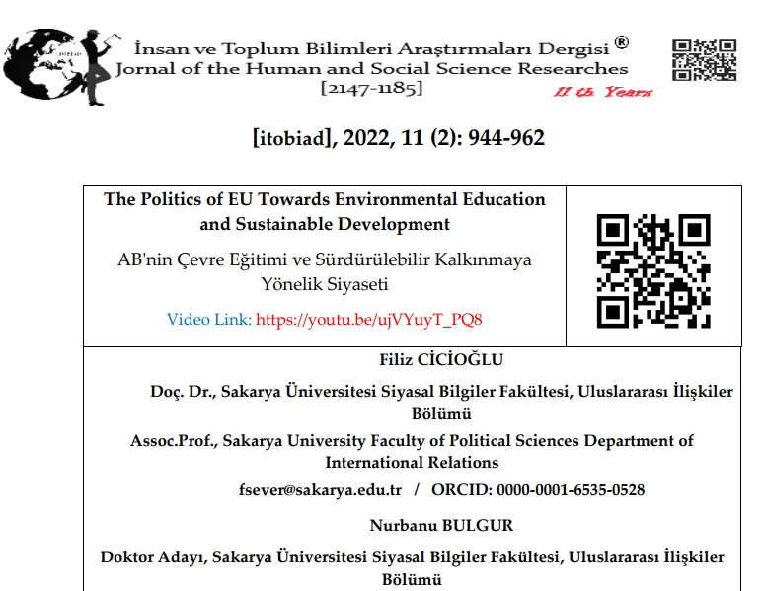
(Bulgur, N., «The Politics of EU towards Environmental Education and Sustainable Development», Journal of the Human and Social Science Researches - www.itobiad.com, p. 944-962).

Slide 5
The main programs opened for environmental education in the EU and their contents are as follows:
1. Sustainability Analysis:
- Under this heading, it is aimed to control the economic and social outcomes of sustainable development by emphasizing the importance of minimizing carbon emission and unconscious resource use (Elkington, 1994, p.95).
- This topic is considered important for this reason and it is stated that sustainability can only be achieved with good waste management and recycling policy. Every member of the EU can bring waste management to a new level by suggesting ways to reduce costs and reduce the associated environmental impact. Distribution of waste generation and treatment reduce impacts on ecosystems and human health will be succeeded by avoiding landfills and encouraging more recycling (“Climate Change: What the EU is Doing”).

Slide 6
2. Multidimensional Analysis of Renewable Energy:
Considering the energy need on one side and the ecological balance and protection of the environment on the other, the use of environmentally friendly resources becomes important in meeting the increasing energy need in the long term. This approach brings to the agenda the provision of energy with the understanding of sustainable development.
The development of sustainable energy policies is one of the fundamental dimensions of sustainable development. The definition of the concept was accepted at the World Summit held in Rio in 1992 and was explained in the Rio Declaration as “the development that takes place today should not pose a threat to the needs of today and our future”.

Slide 7
3. New Sustainable Business Models
The concept of sustainable development with economic, social, and environmental dimensions; has sensitivities such as the continuation of the competitive understanding of the economic system, increasing welfare, and meeting consumer demands.
In a global sense, the issue of sustainability was first addressed with economic growth and development in the United Nations Conference on Human Environment in 1972 in Stockholm (“Declaration of the United Nations Conference on the Human Environment”, 1972). In the study titled “Limits of Economic Growth” published in the same year, two different necessary components were identified as physical and social needs.
As long as we have environmental security issues, we will have more and more green jobs/new business models.

Slide 8
FIVE PIONEERING ENVIRONMENT-FRIENDLY UNIVERSITIES
Wagenıngen Unıversıty IN GERMANY
Algebra University in CROATIA
Aarhus University in DENMARK
Tallinn University of Technology- ESTONIA
EHL Hospitality Business & Hotel Management School- Switzerland

Slide 9
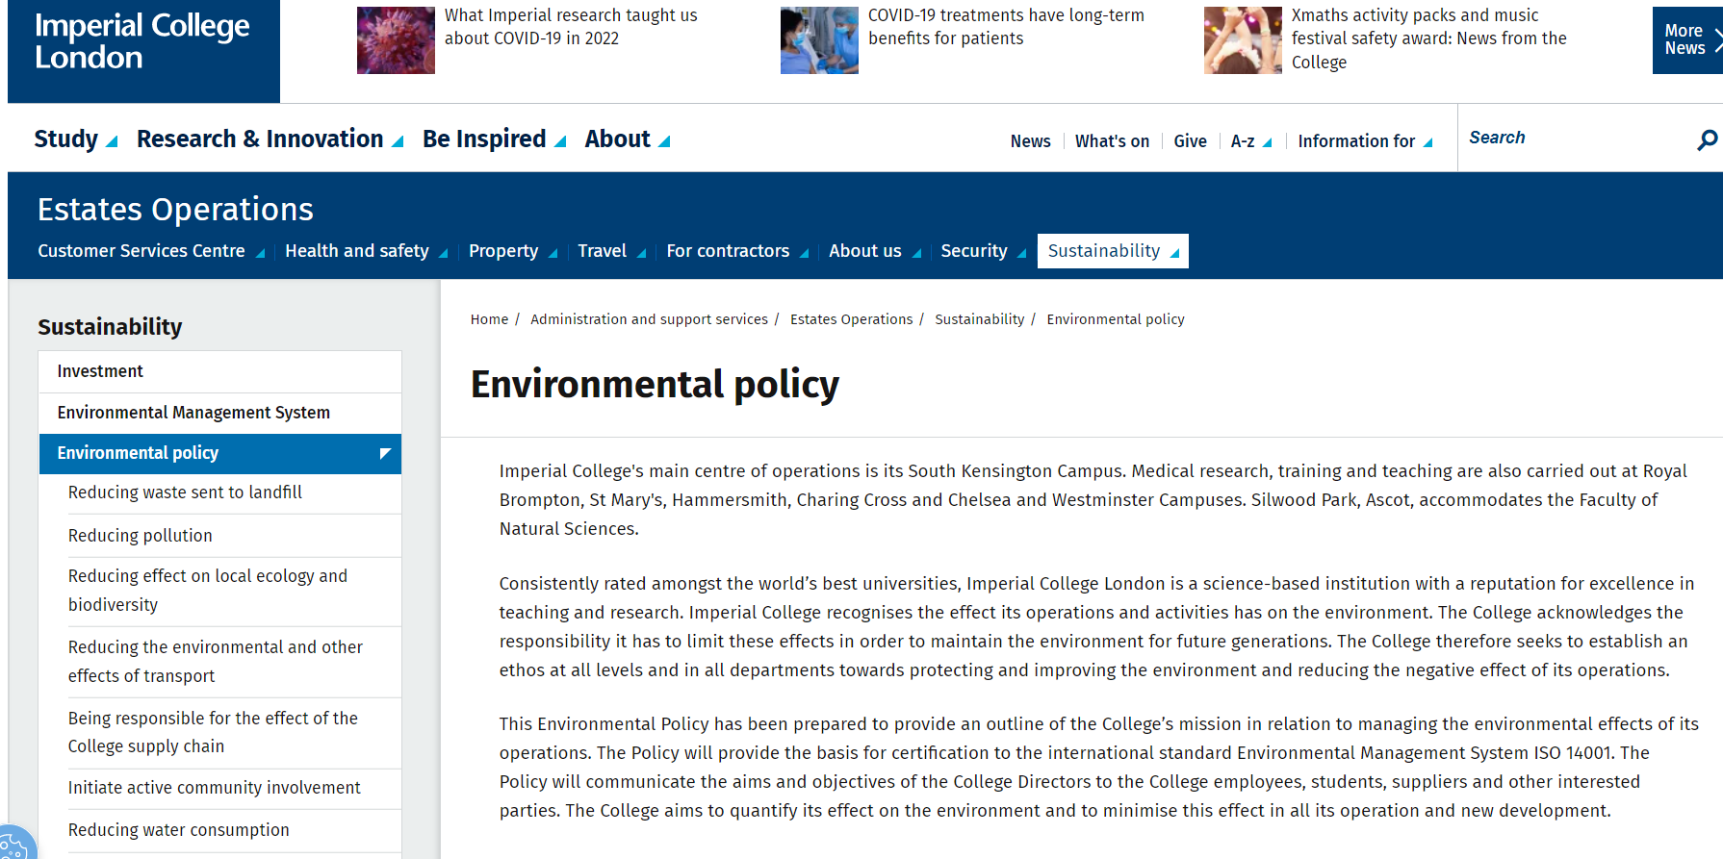
Environmentally Friendly University Models and Environmental Protection Strategies

Slide 10
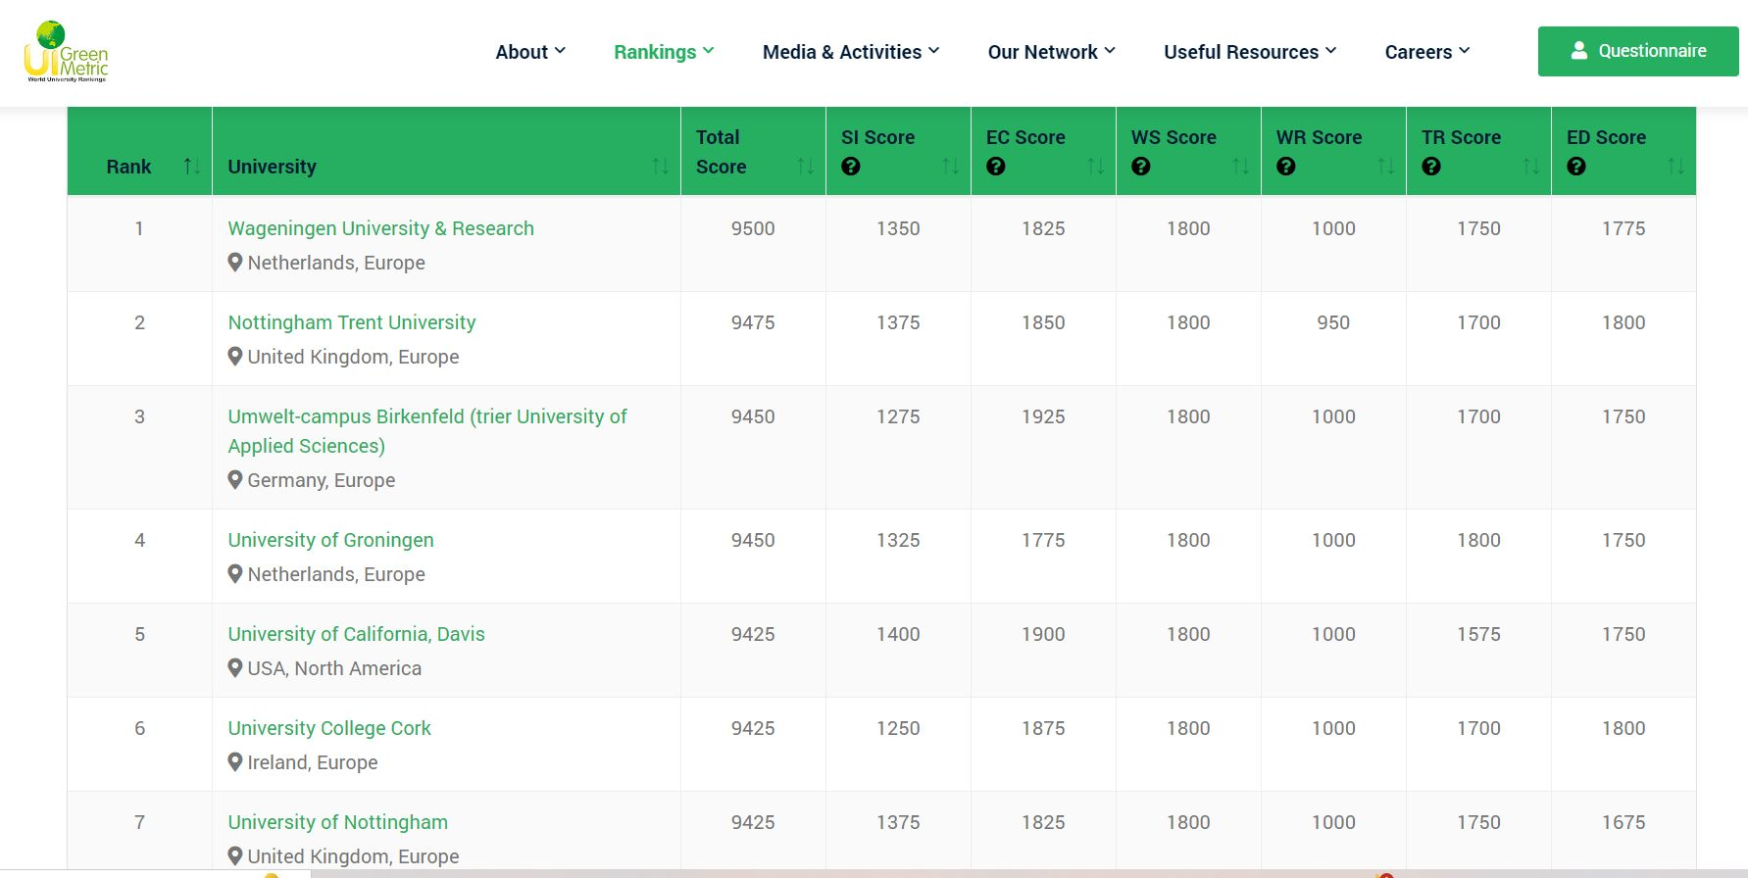
GREENMETRIC Overall Rankings-2023

Slide 11
WHAT ABOUT THE UNIVERSITIES IN TURKIYE??

Slide 12
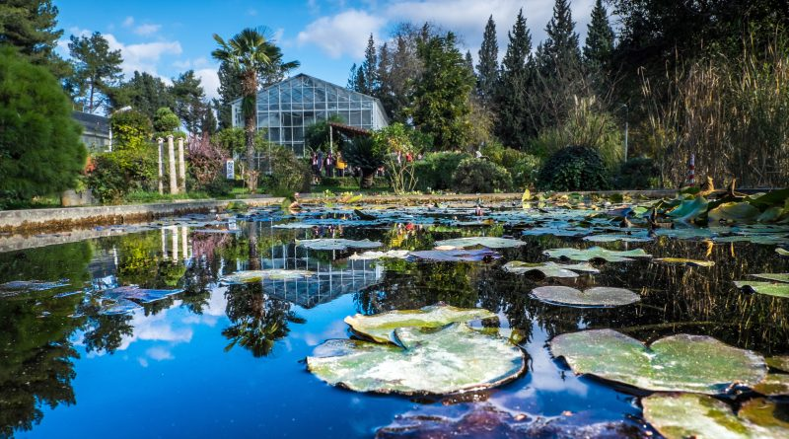
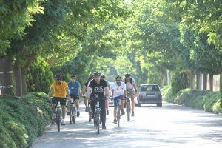
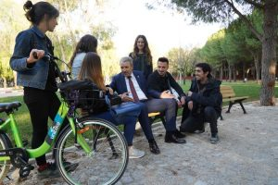
EGE UNIVERSITY/IZMIR
“Cooperation Protocol in the Field of Creating a Sustainable and Climate-Friendly Campus” - Ege University
05.10.2022
10 Pilot Universities
1. Climate-Friendly Campus Strategy Compatible with Sustainable Development Goals

Slide 13
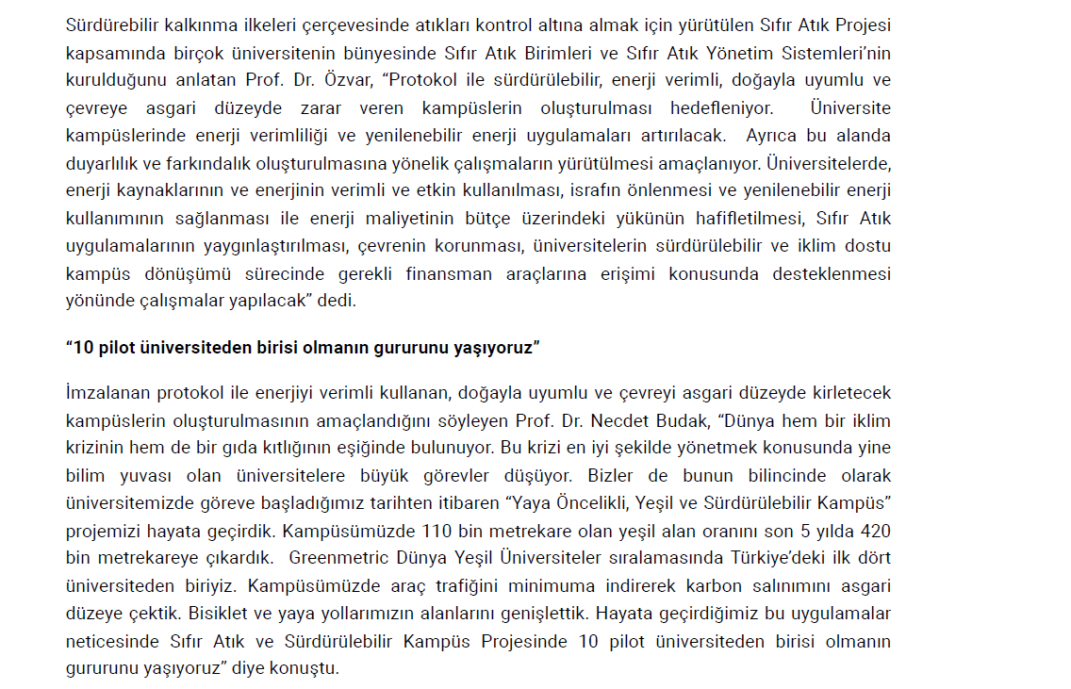
2. Renewable energy strategy and protection of green areas

Slide 14
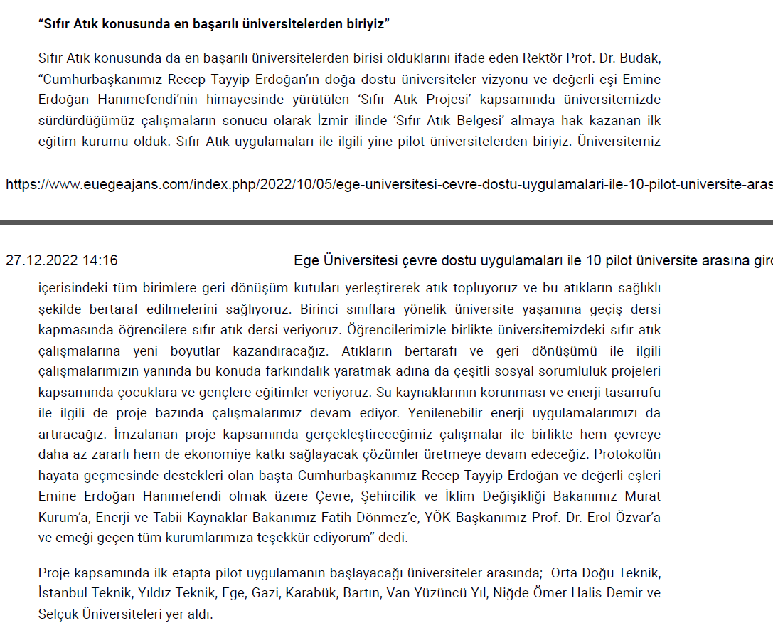
3. Zero Waste Policy-Zero Waste Certificate

Slide 15
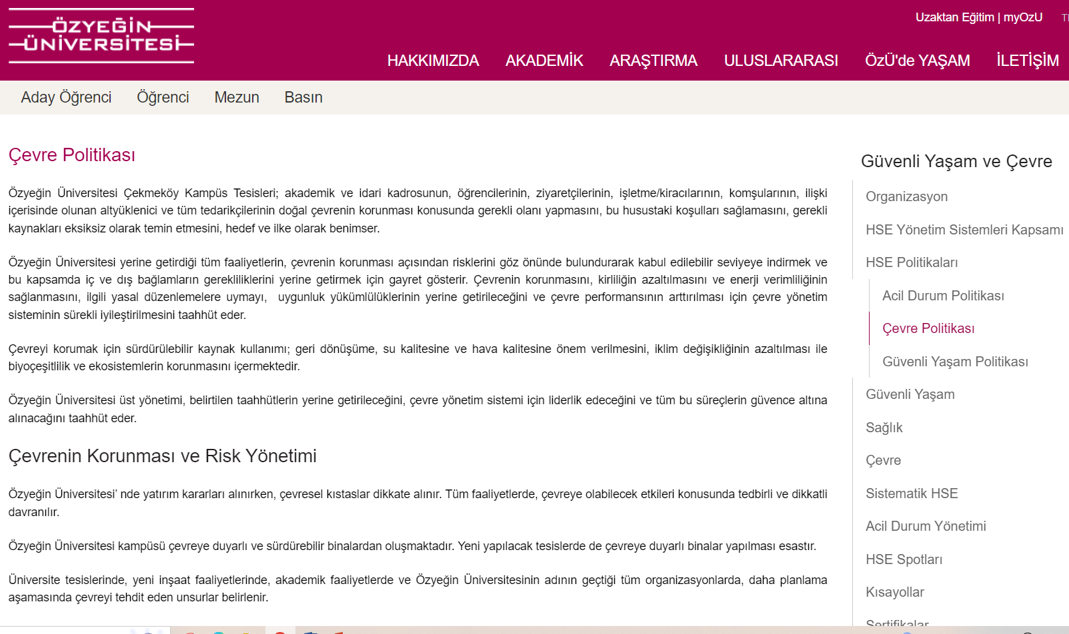
ÖZYEĞİN UNIVERSITY/ISTANBUL
Environmentally Friendly University Models and Environmental Protection Strategies

Slide 16
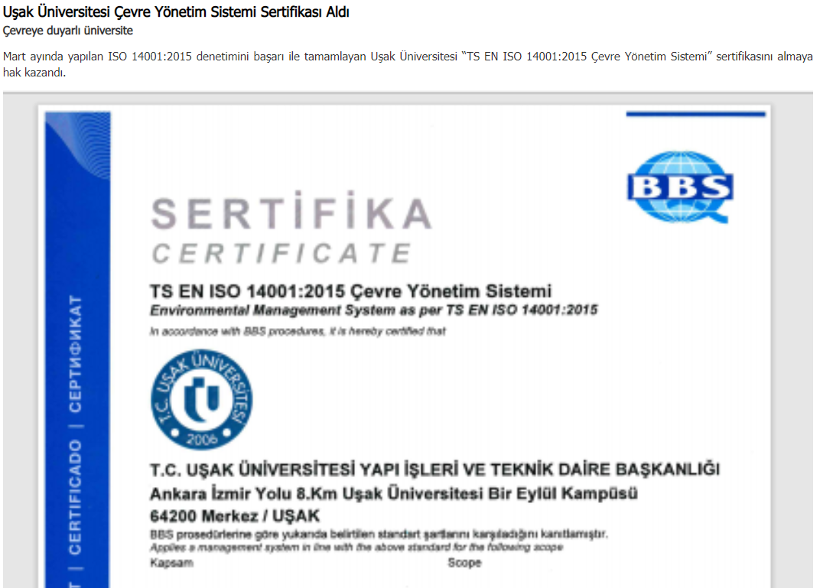
UŞAK UNIVERSITY
They received 14001:2015 environmental management certificate as Sakarya University.

Slide 17
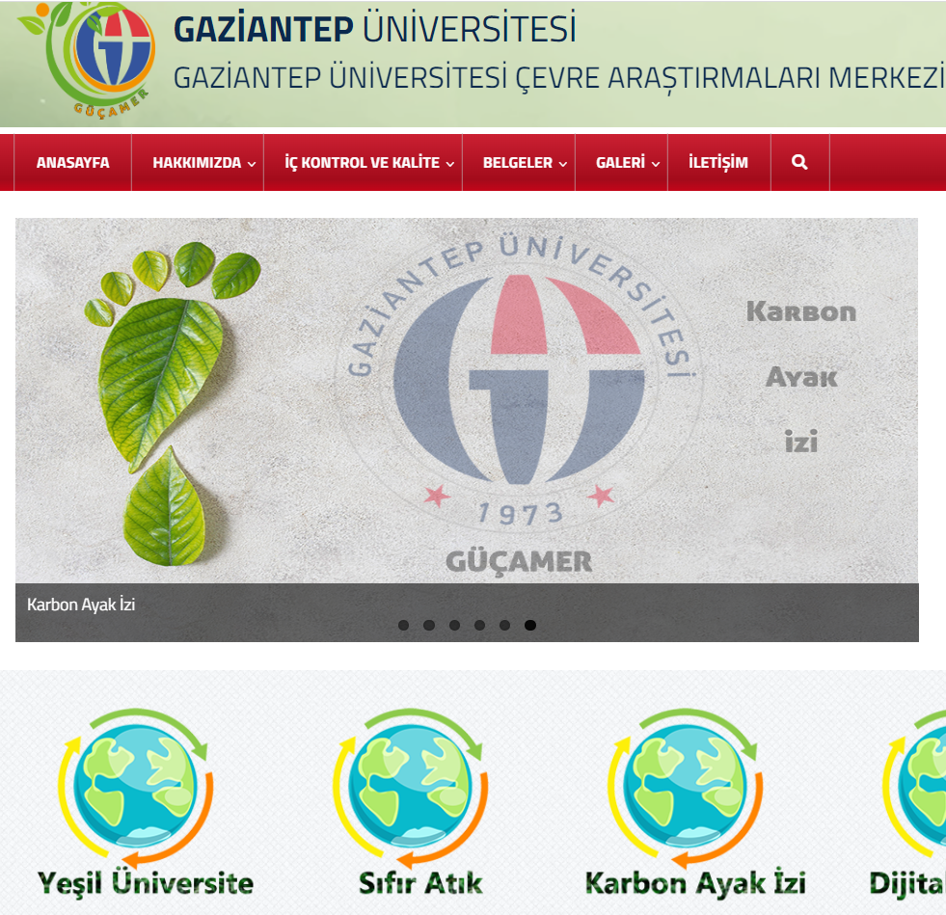
GAZİANTEP UNIVERSITY
They have «Environmental Research Center with some concepts like zero-wastement policy, green campus, carbon emision e.t.c.»

Slide 18
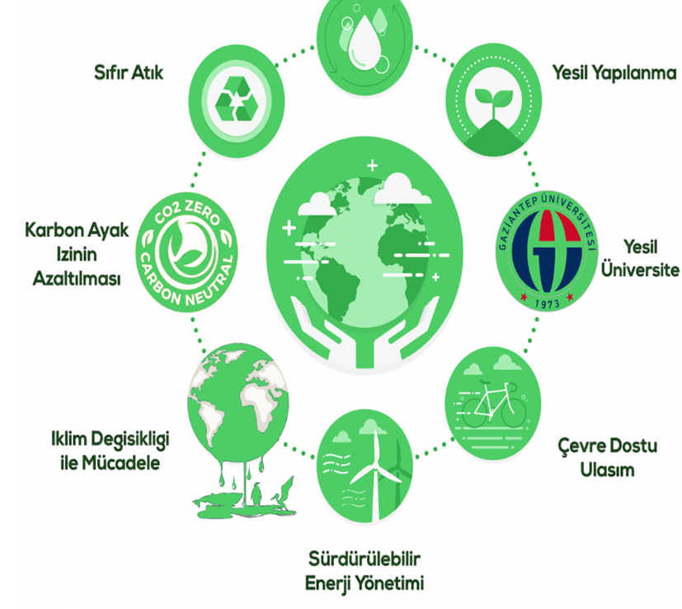
Gaziantep University Environmental Protection Goals

Slide 19
Sakarya Unıversıty’s Policy objectives and environmental analysis aligned with the Sustainable Development Goals

Slide 20
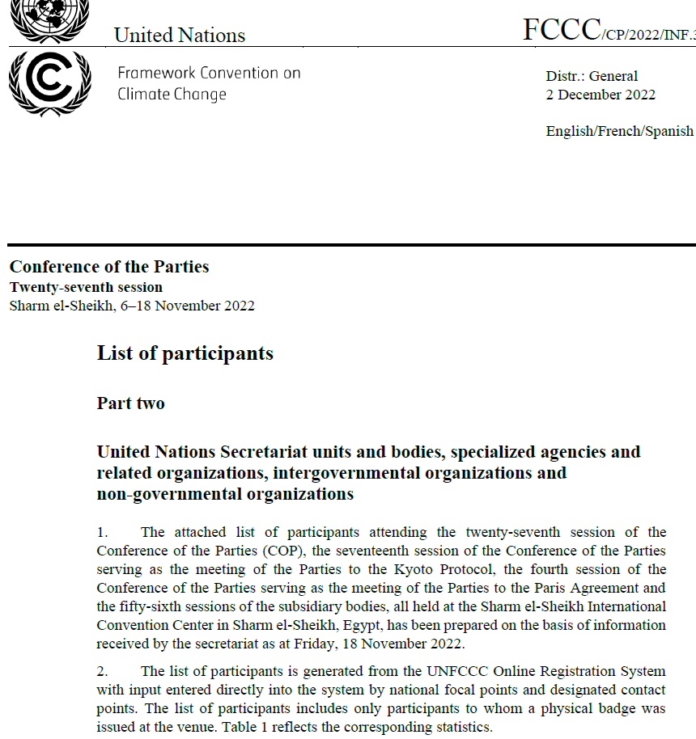
International Environmental Platforms-UNFCCC

Slide 21
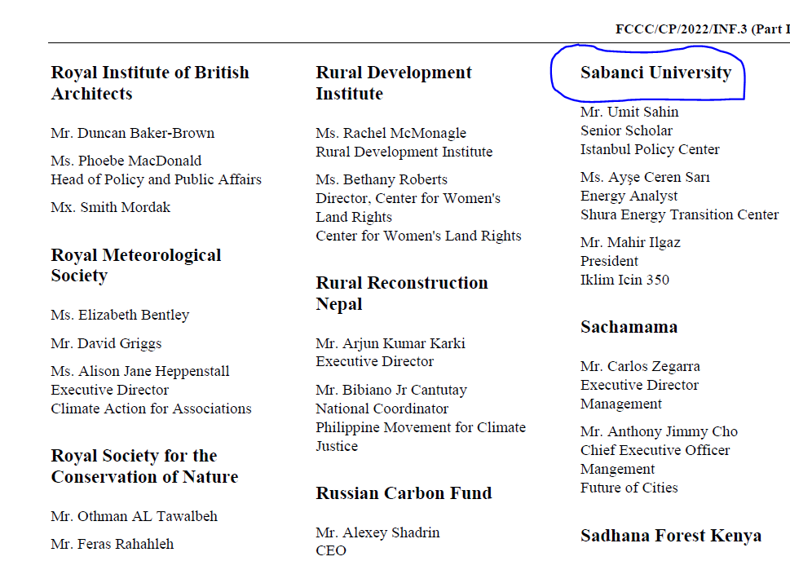

Slide 22
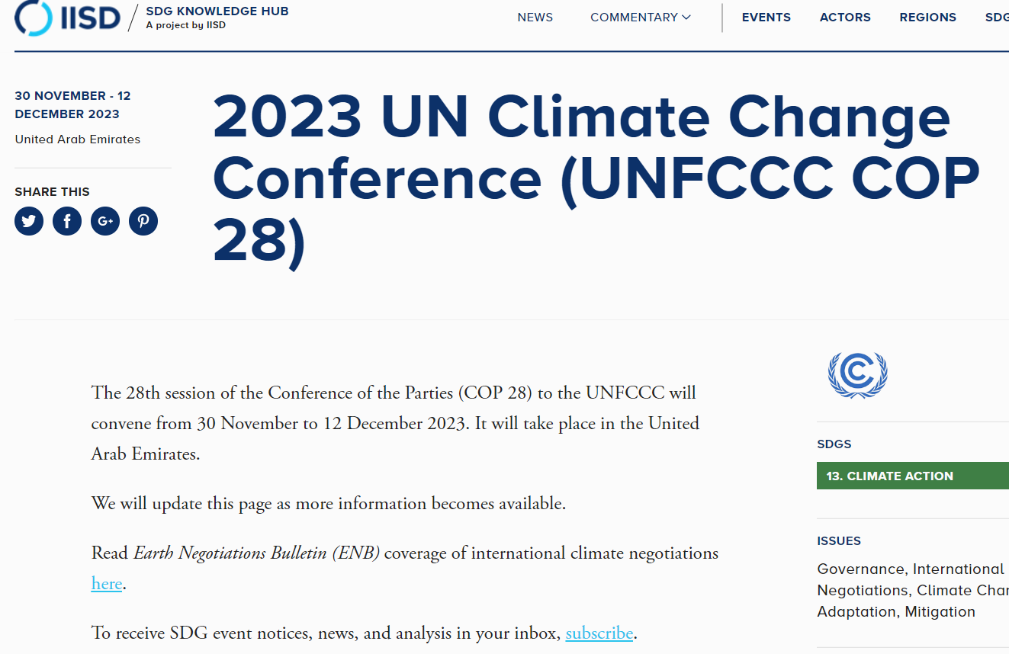

Slide 23
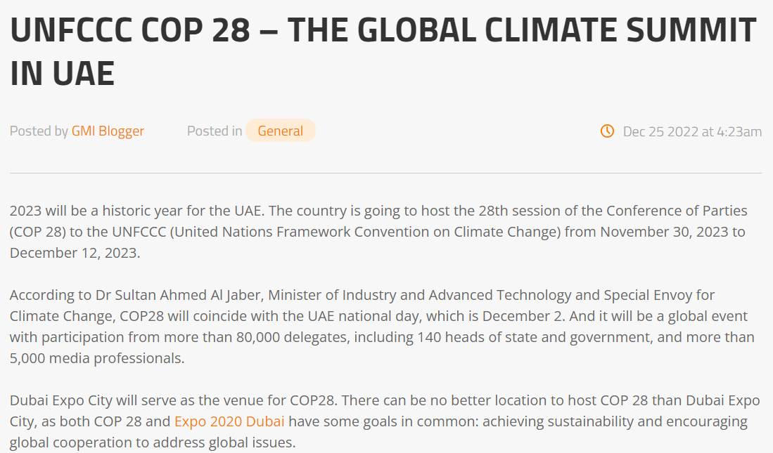

Slide 24
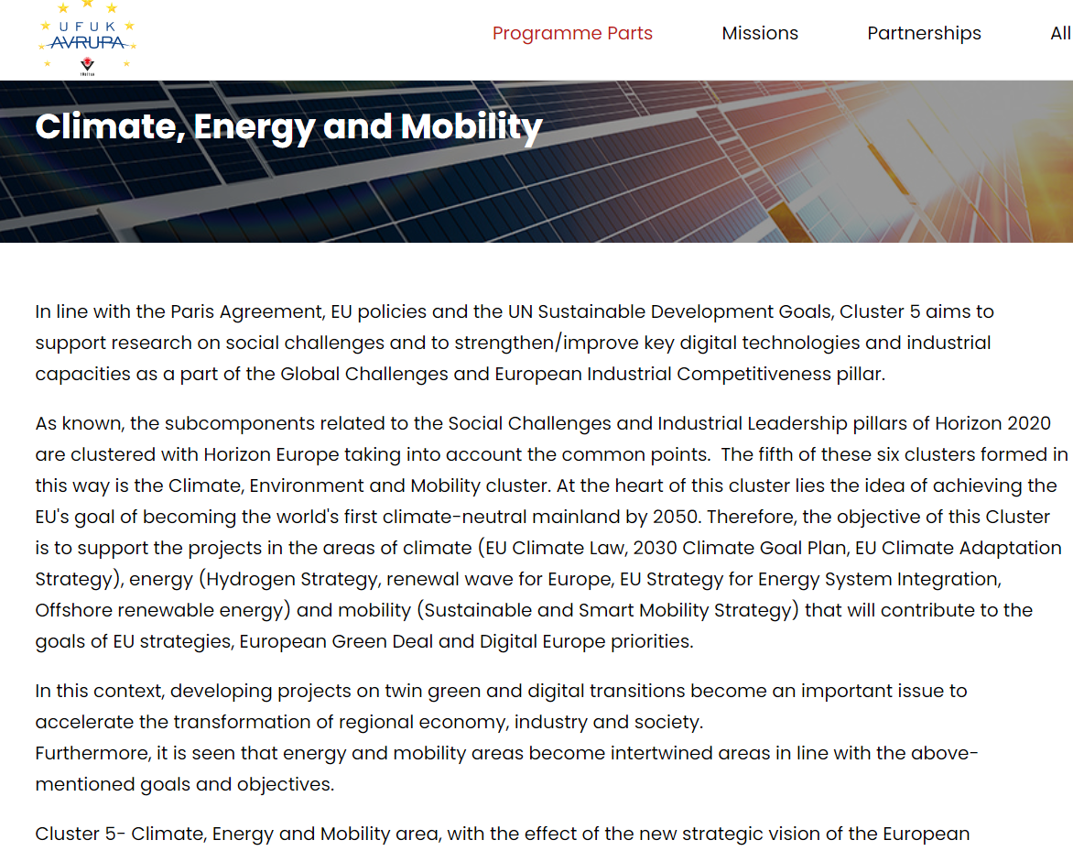
HORIZON EUROPE ENVIRONMENT CHAPTER-»CLIMATE, ENERGY AND MOBILITY»

Slide 25
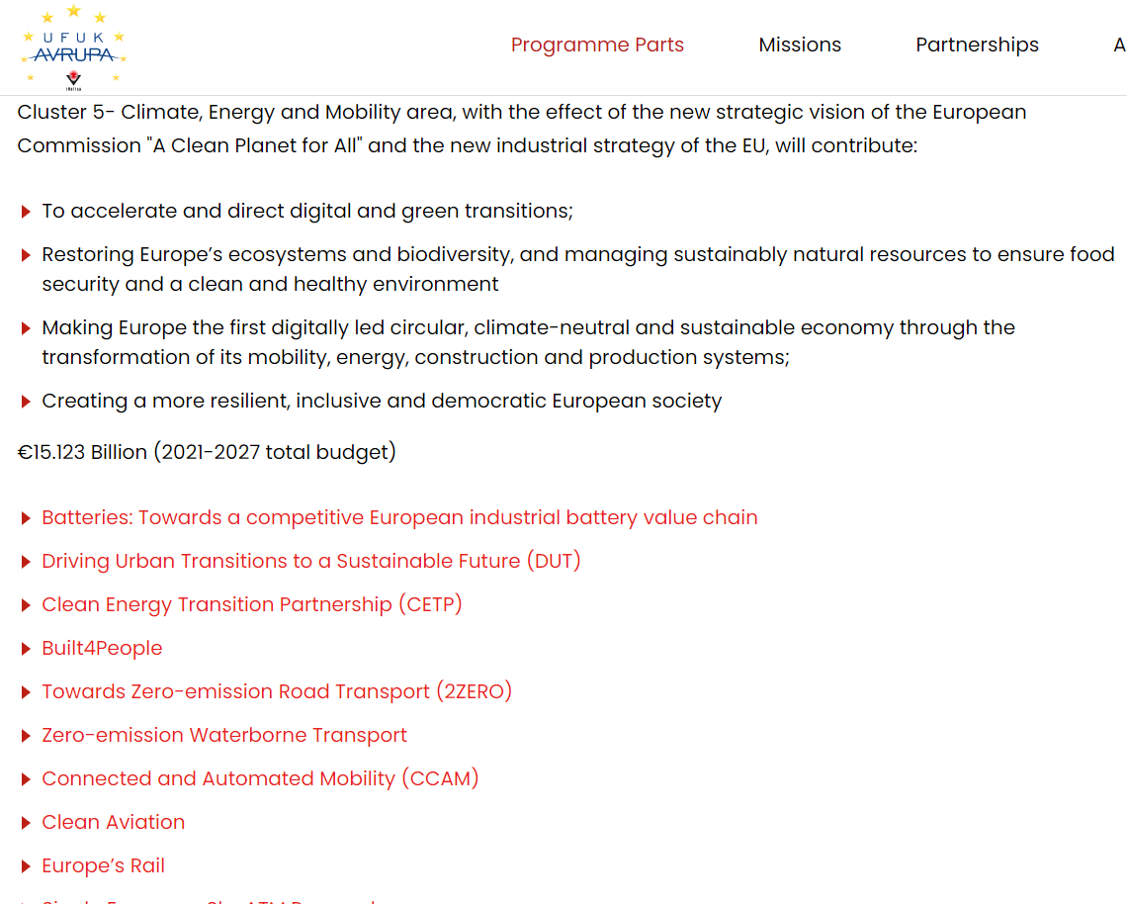

Slide 26
THANK YOU FOR YOUR ATTENTION! ☺

