Slide 1
FIJI NATIONAL UNIVERSITY

Slide 2


Slide 3
About FNU
The Fiji National University (FNU) was formally constituted in 2010 by the Fiji National University Act 2009, which amalgamated six government higher education colleges.
These were:
Fiji School of Medicine (est. 1885)
Fiji School of Nursing (est. 1893)
Fiji College of Advanced Education (est. 1947)
Fiji College of Agriculture (est. 1954)
Fiji Institute of Technology (est. 1963)
Lautoka Teachers’ College (est. 1978).

Slide 4
About FNU
The University now has 5 founding colleges namely:
    College of Agriculture, Fisheries and Forestry (CAFF)
    College of Business, Hospitality and Tourism Studies (CBHTS)
    College of Engineering, Science and Technology (CEST)
    College of Humanities and Education and (CHE)
    College of Medicine, Nursing and Health Sciences (CMNHS)
In 2021 the Fiji Maritime Academy (FMA), formerly part of CEST, became an independent college.
The University also includes the National Training and Productivity Centre (NTPC) which has a national network of smaller training campuses in Suva, Nadi and Lautoka.
The University also has two out-reach campuses in Ba and Labasa.

Slide 5
Summary
Approximately 21,000 students pass through the University each year.
Formally established in 2010 by the merger of several existing technical colleges
The CMNHS is a merger of the two oldest schools of higher education – the Fiji School of Medicine (est 1895) and the Fiji School of Nursing (est 1893)
CMNHS – 230+ academic staff and up to 2400 students enrolled in 60+ programmes
75% students UG but 75% of CMNHS programmes are PG
FNU was ranked for the first time in the Times Higher Education (THE) Impact Rankings in 2022 (measure an institution's research, outreach, teaching and stewardship against the United Nations Sustainable Development Goals (UN SDGs))

Slide 6
Global recognition
The Fiji National University (FNU) was ranked for the first time in the Times Higher Education (THE) Impact Rankings which measure an institution's research, outreach, teaching and stewardship against the United Nations Sustainable Development Goals (UN SDGs).
To be included in the ranking, universities must be actively involved in achieving the SDGs.

Slide 7
Global recognition
The ranking was attributable to excellent research, outreach programmes, teaching, and the University’s firm commitment to the UN SDGs.
The FNU’s Strategic Plan 2021-2026 outlines the university’s deep commitment to the achievement of the UN Sustainable Development Goals (SDGs), and to developing cost-effective, scalable solutions aimed at sustainability, resilience and climate change adaptation.

Slide 8
Global recognition
The University’s sustainability targets include:
net zero emissions by 2050
divert 25% of waste from landfill by 2026
20% percent reduction in potable water use by 2026
introduction of sustainable procurement practices to reduce waste and increase social sustainability.

Slide 9
College of Medicine, Nursing & Health Sciences (CMNHS)
Dean
Associate Dean Learning & Teaching
School of Health Sciences (Head)
School of Medical Sciences (Head)
Associate Dean Research
School of Public Health & Primary Care (Head)
School of Dentistry & Oral Health (Head)
School of Nursing (Head)
FIPHR

Slide 10
Total Programmes (77)
Short courses
2 - Short Courses
Total Recorded programmes (77)
5 - Certificate (Level 4)
3 - Certificate (Level 5)
3 - Diploma (Level 6)
14 - Degree (Level 7)
1 - Postgraduate Certificate
31 - Postgraduate Diploma
18 - Masters
HDR (2)

Slide 11





RESEARCH UPDATES

Slide 12
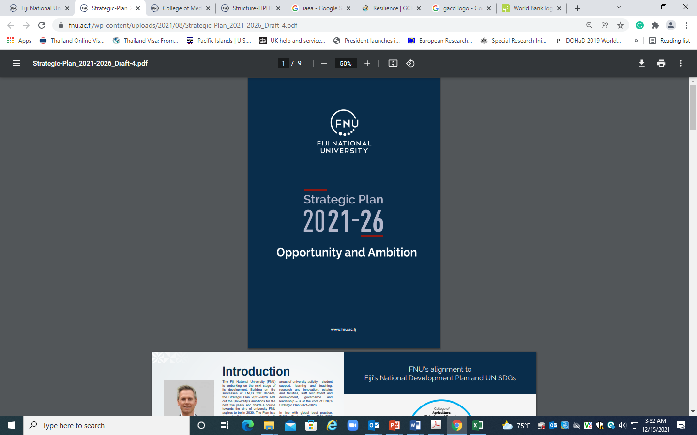

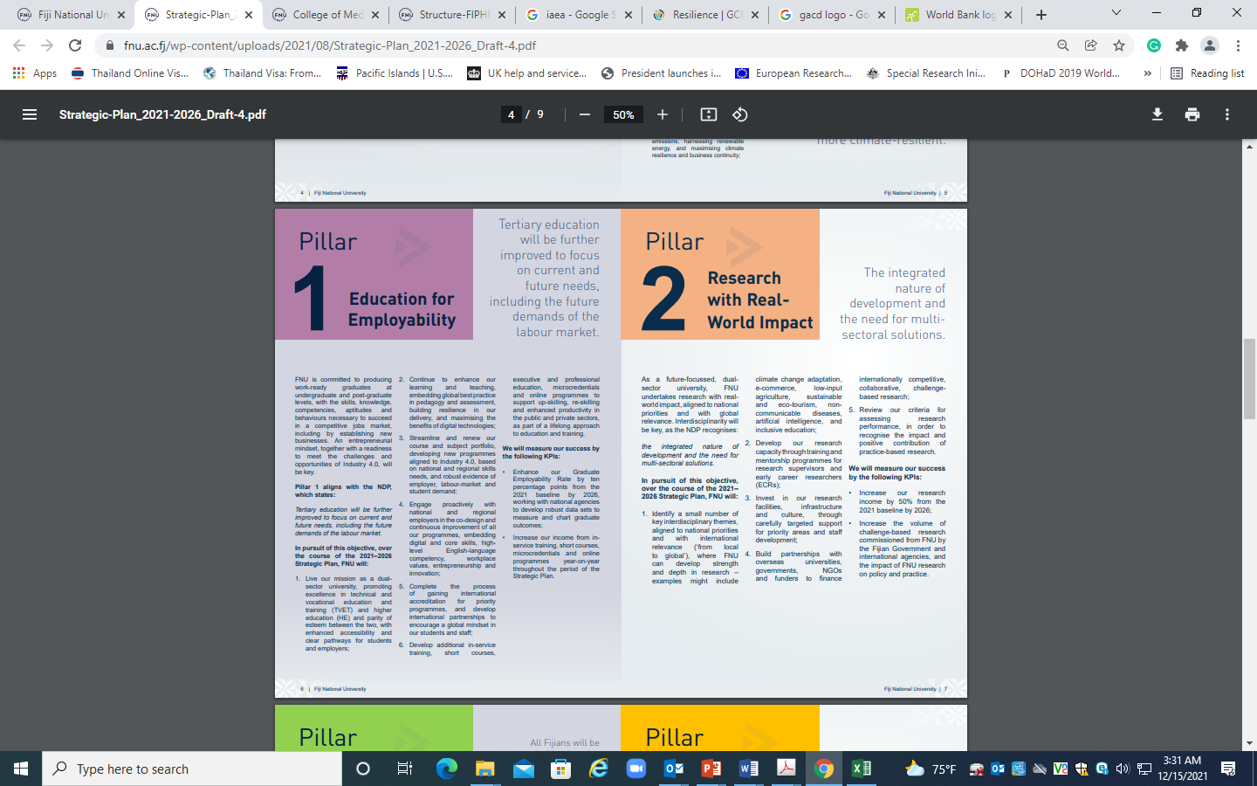
Aligned
https://www.fnu.ac.fj/college-of-medicine/wp-content/uploads/sites/6/2020/09/Fiji_Institute_of_Pacific_Health_Research_Strategic_Plan_2020-2025.pdf
https://www.fnu.ac.fj/wp-content/uploads/2021/08/Strategic-Plan_2021-2026_Draft-4.pdf

Slide 13
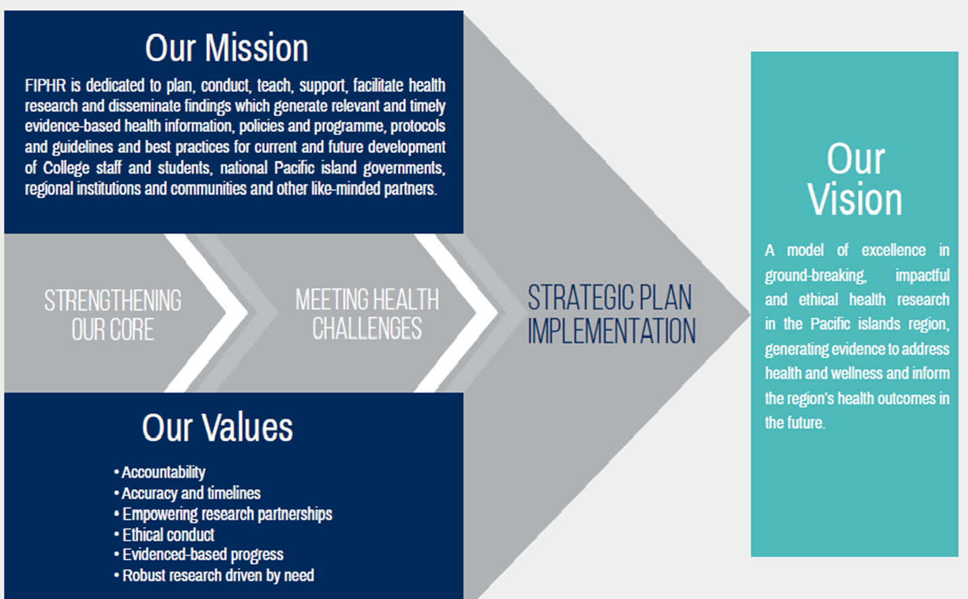


Slide 14

STRENGTHENING OUR CORE: STRATEGIC PRIORITY AREAS
High Quality Research Environment
Research Dissemination & Translation
Research Capacity Development
Governance & Resourcing of FIPHR

Slide 15
Research Training & Data Repository
Summary of Achievements: 2023
Launched the SOP for Human Health Research Ethics & Convened a stakeholders meeting
Hosted the first Virtual Conference for the Pacific Islands Health Research Symposium
Health Security in the Pacific: Lessons from the pandemic experience
RISE Lab is now ISO 9001 certified
Launched (Soft) the Communicable Disease Research Centre

Slide 16
STUDENT RESEARCH UPDATES
Average of 80 Masters research projects completed every year (40% clinical programmes; 40% regional students)
Average 40-80 operational research projects every year by DDM/PGCFE programme across the PICT’s
Av 30% publication rate of completed research – while we are capacity building in manuscript writing/publishing, also established Pacific Health Observatory & FNU/CMNHS Research Repository
  Knowledge translation platform
  Research repository for collection of all Pacific health literature, especially unpublished work

Slide 17


Slide 18
FINANCE & HR

Slide 19

FINANCIAL SUSTAINABILITY (HR & Finance)
CMNHS “BALLPARKS”
  Annual budget roughly $21-25 million
  HR budget roughly $12-16million;
  Over the years, HR budget line not fully expended because of the difficulty to find the right people to engage in special clinical disciplines
  Surplus funds to CAPEX funds
Challenges:
    CMNHS is a big revenue earner and also a big spender … it’s a problem because we have to subsidize a school (School of Dentistry is a small school with a high running cost).
    Study allowance and PTD – when we have a very high operational cost, it takes away the opportunity to award staff for PTD
    Consumables cost and VAT now increased
    Appropriate inventory for consumables – can be quite expensive when not done appropriately

Slide 20
























Our Partners

Slide 21

ERASMUS +
KA107 PROGRAMME
USP’s EXPERIENCE with ERASMUS +
Notes:
The adventure continues. Once you have completed your journey as a student, your new adventures await.

Slide 22
ERASMUS + KA 107 PROGRAMME SIGNED
The University of the South Pacific has been a partner in the Erasmus + programme since 2017
Prior to this The University of the South Pacific was a partner, co-coordinator and coordinator in the previous Erasmus Mundus programme
The Erasmus + programme supports USP’s strategic plan
AGREEMENT | PROJECT YEAR | FIELD
University of Göttingen | 2016 -2018 | Ethnology
University of Ljubljana | 2016-2018 | Business Administration Economics
University of Tartu | 2017-2018 | Carrer Counselling / International Office
 | 2018-2020 | Tourism and Hospitaliy Management
University of Sofia | 2018-2021 | Engineering
University of Palermo | 2018-2020
University of Timisoara | 2017-20201 | Electricity and Energy, Mechanics and Metal Work. Electronics and Automation, Engineering: Professional, scientific and technical activities Administrative and support service activities
Universidad de Valladolid | 2017-2019 | Chemical Engineering, Environmental Science, Education, Literature and Language, Forestry, Commerce, Social and Behavioural Science, Engineering
 | 2018-2020
 | 2019-2021
 | 2023
Babes Bolyai University | 2019-2021 | Journalis, Political Science, Business and Law Admin, Public Health,

Slide 23
New KA107 Partnership Proposal
- In November of 2023, USP was approached by 7 new partners to fill our a KA107 proposal form. Today we have received confirmation that all of this 7 new KA107 proposal was approved
UNIVERSITY | FIELD | COMMENT
University of New Caledonia | Open | Approved
Humbolt University | Sociology, Gender, Agricultural Ecology, Environment and Oceas | Approved
Afyon Kocatepe University | Business Administration | Approved
University of Oradea | International Relations, Tourism Geography, International Business, Business Administration | Approved
Ovidius University of Constanta | Ecology, Aquatic Biology | Approved
Sakarya University | Mechanical Engineering | Approved
Universidad Rey Juan Carlos | International Relations (EN). -Marketing (EN) -Tourism (EN). -Economics (EN). -Business Administration & Management(EN) -Primary Education (EN). -Pre-primary Education (EN). | Approved

Slide 24
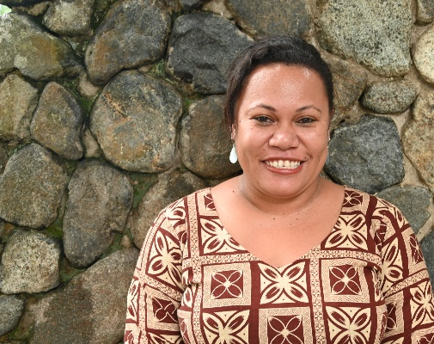
ERASMUS + National Focal Point (Pacific)
Ms Lillian Fuata
lillian.fuata@usp.ac.fj / +679 3231753
Manager International Office
The University of the South Pacific

Slide 25
THANK YOU
Contact Details:
Phone
Email
Notes:
The adventure continues. Once you have completed your journey as a student, your new adventures await.

