Slide 1
Academic Cooperation
in
International Networking
International Relations Office
www.btu.edu.tr
@bursatechnical

Slide 2
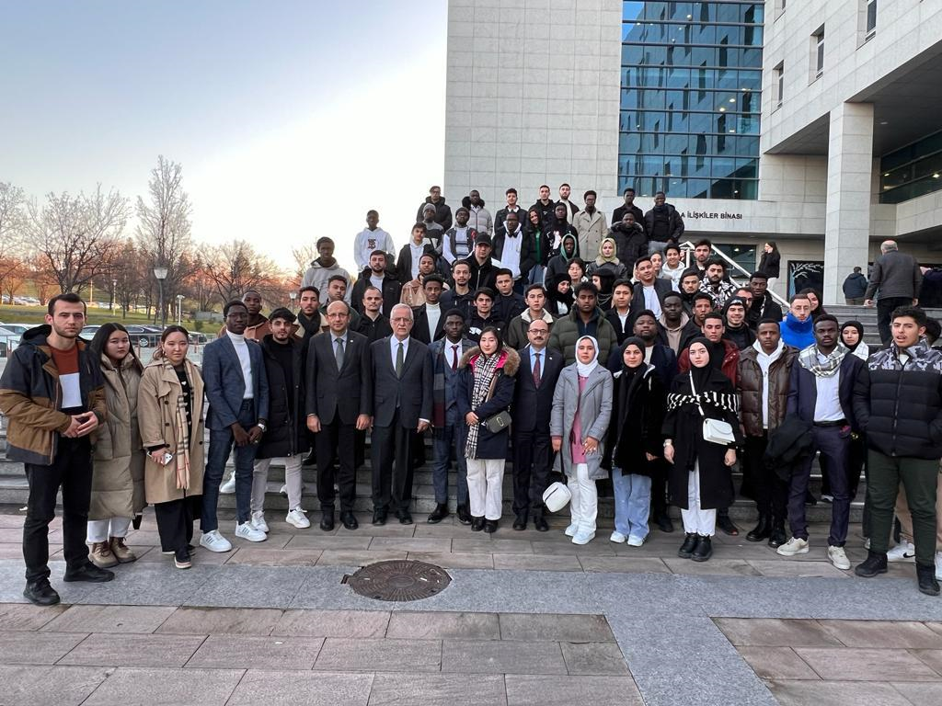
AcademIc CooperatIon at BTU :
Erasmus+ KA131
Erasmus+ KA171
Erasmus+ KA2 projects
European Universities
Visiting Scholars
International Students and Bursa TÖMER

Slide 3
Erasmus+ KA131 :
Mobility for students and staff with EU programme countries.
Mobility through KA131 projects and KA131 Consortium projects between Turkish universities.
Expanding cooperation with :
visits to partner universities and potential partner universities.
good communication with partner universities.
taking advantage of academic staff’s international connections.
focusing on similar or smaller scale universities.

Slide 4
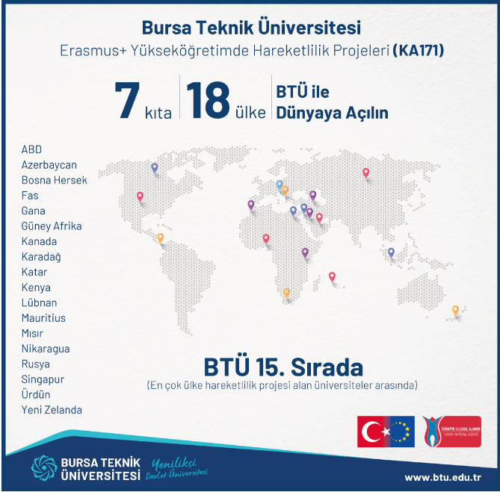
Erasmus+ KA171
Mobility for students and staff worldwide with universities from 18 different countries.

Slide 5
ERASMUS+ ka2 PROJECTS
2016-2018 : INNOWOMENT
‘Innovative Women Entrepreneurs of the Future’
BTU as Project Coordinator
2017-2020 : WEST
‘Women Entrepreuneurs Supporting Tribune’
BTU as partner with Bursa Social Security (SGK)
2020-2021 : MEDLENTISK
‘Partnership for an exchange of best practices on mastic tree fixed oil’
BTU as partner with the International Association for Mediterranean
Forests
2019-2022 :
‘Young Trade Ambassadors’
BTU as partner with BTSO (Bursa Chamber of Commerce)
2020-2022 : FOODTR
‘Increasing Food Literacy Competencies of Adults’
BTU as partner with Bursa Central Research Institute
for Food and Feed Control

Slide 6
European Unıversıtıes ALLIAnce :
Application to the 2024
European Universities call
in the field of Blue Economy.

Slide 7
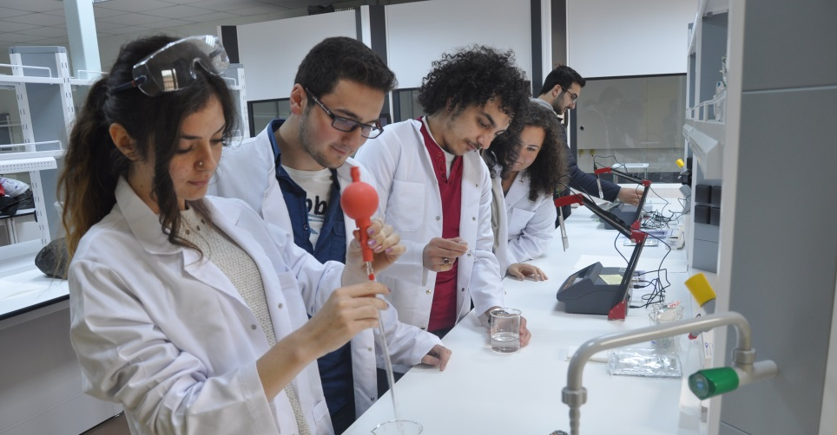
Vısıtıng Scholars :
2221 - Tübitak Fellowships for Visiting Scientists and Scientists on Sabbatical Leave
Visiting Scholars

Slide 8
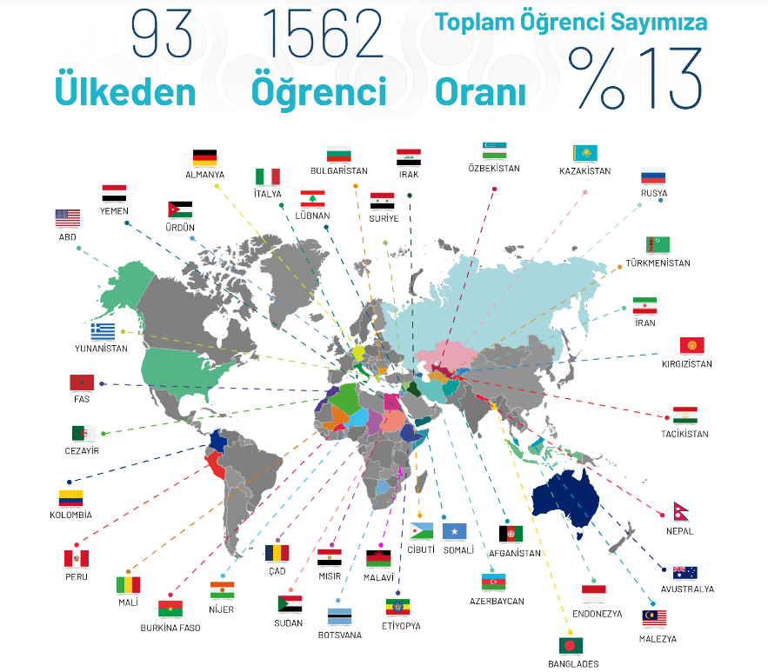
Internatıonal Students are our ambassadors ALL around the world !
International
Student
Ratio
Countries
Students

Slide 9
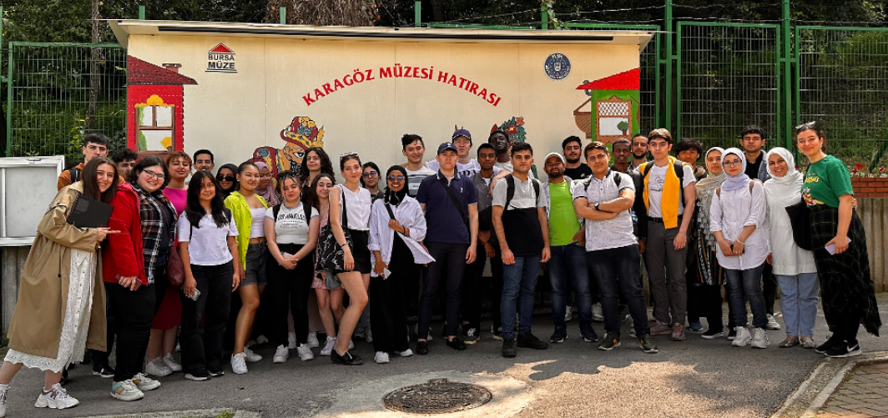
BURSA TÖMER :
Turkish Language Preparatory Course and Exams for International Students (A1 to C1 level)

Slide 10
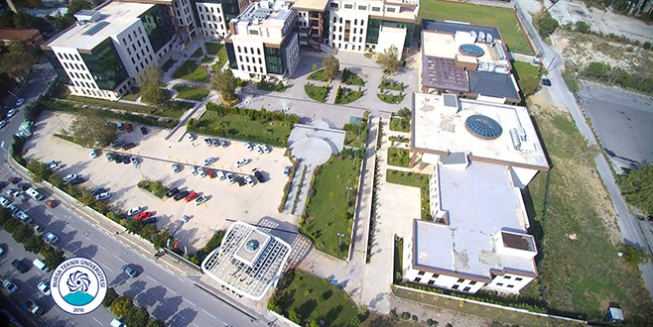
Contact us :
intoffice@btu.edu.tr
erasmus@btu.edu.tr
@bursatechnical
www.btu.edu.tr
www.intoffice.btu.edu.tr
www.erasmus.btu.edu.tr

