Slide 1
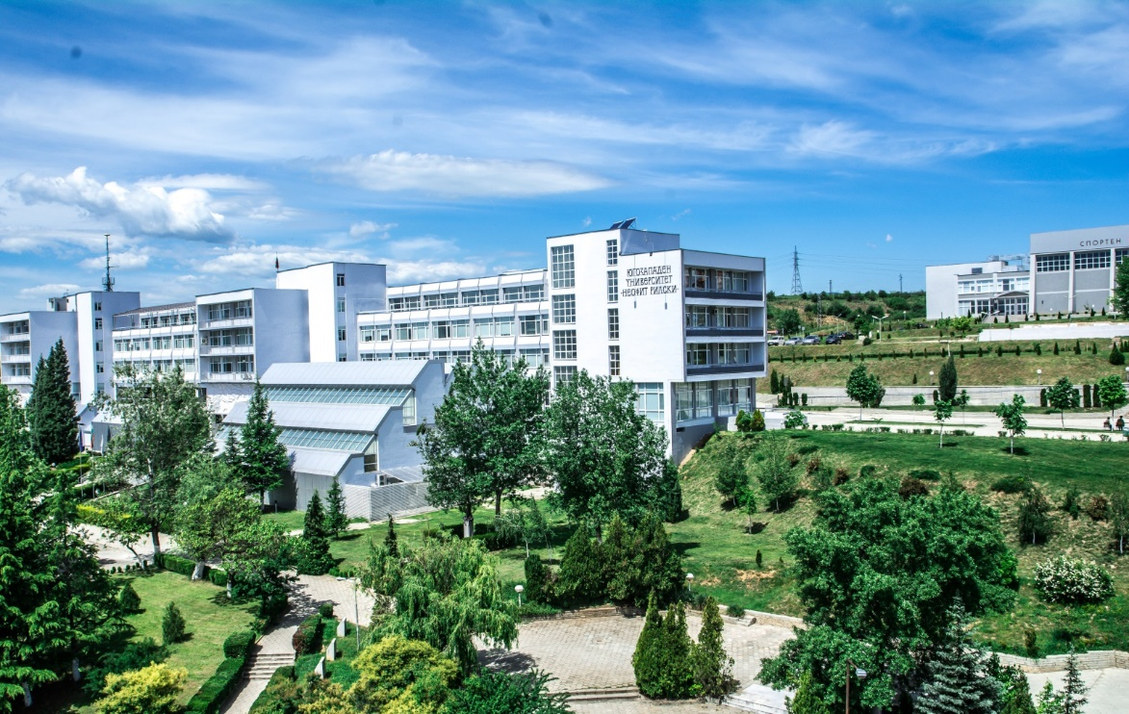
South-west University “Neofit Rilski” Blagoevgrad - Bulgaria

Slide 2
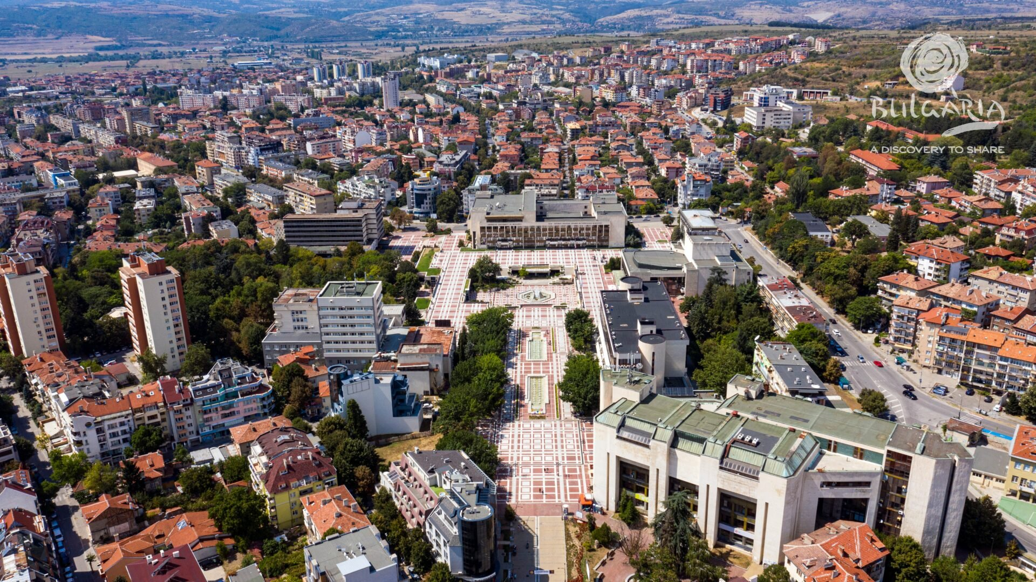
Blagoevgrad
Blagoevgrad is a regional city with many historical sights, museums, wonderful parks, opportunities for recreation, entertainment and suitable for students.
Blagoevgrad is located in the Struma River valley.

Slide 3
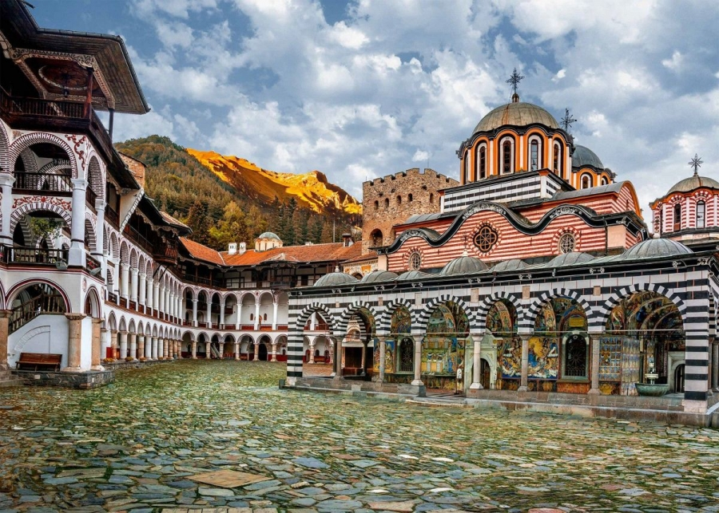
BLAGOEVGRAD
The city is located a few kilometers from the North Macedonian and Greek borders;
Blagoevgrad is located 100 km from the capital of Bulgaria - Sofia;
Nearby is the largest monastery on the Balkan Peninsula - Rila Monastery;

Slide 4
Blagoevgrad

Slide 5
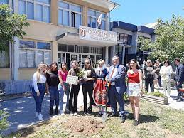
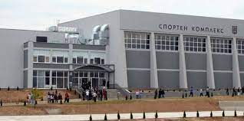
South-west university “Neofit Rilski”
The university has the following faculties:
Faculty of Law and History
Faculty of Economics
Faculty of Natural Sciences and
Mathematics
Faculty of Public Health and Sports
Faculty of Pedagogy
Faculty of Philology
Faculty of Philosophy
Technical Faculty
Faculty of Arts

Slide 6
South-west university “Neofit Rilski”
South-West University is a state institution that offers training in Bulgarian and English in 80 Bachelor's and Master’s programs after secondary education, 121 Master's programs after completed Bachelor’s degree and 88 PhD programs.
The education is provided in 30 professional areas in almost all fields.
More than 11 500 students of whom 500 are coming from various countries such as China, USA, Japan, Greece, Turkiye, Cyprus, Serbia, Albania, Moldova, Ukraine, North Macedonia, France, Yemen, etc.
Over 800 lecturers including professors, associate professors and assistant professors.
www.swu.bg

Slide 7
Law and history Faculty
The biggest one in the university
Studied Majors:
Law
International Relations
Public Administration
History
Public Relations
National Security

Slide 8
Law and history Faculty
Motto: “Open to the world”
European programs
Convertible diplomas
Modern educational technologies
Intensive exchange of learners and staff
Research activities
www.law.swu.bg

Slide 9
Law, Politics, administration Journal

Slide 10
International politics journal

Slide 11
Other Journals

Slide 12
RESEARCH INFRASTRUCTURE
UNIVERSITY RESEARCH CENTRES
LABORATORIES
OBSERVATORIES
DOCUMENTARY CENTRES, ETC.

Slide 13
RESEARCH CENTRES
Multimedia Centre of computer archival studies, digital archives and local government history
Centre for Advanced Bioinformatics Research
Research Centre for Eco Energy Technologies
University Center for Functional Research in Sports and Kinesitherapy
University Research Center for Ancient European and Eastern Mediterranean Cultures
Speech Therapy Centre
Centre of German Idealism, etc.

Slide 14
LABORATORIES
E-learning Laboratory at the Faculty of Mathematics and Natural Sciences
Econometric Research Laboratory
Journalism and Book Publishing Technology Laboratory
Laboratory of Ethnology and Folklore Studies
Laboratory of Linguistic Demography of the Balkans
Sociology Research Laboratory
Laboratory of Kinesitherapy, etc.

Slide 15
INTERNATIONAL COOPERATION
Erasmus + the whole spectrum of programs, more than 150 agreements
Institutional contracts for cooperation – more than 100
European and other international projects
Joint diplomas, etc.

Slide 16
UNIVERSITY life

Slide 17
Invitation
YOU ARE VERY WELCOME TO SOUTH-WEST UNIVERSITY AS ERASMUS+ STUDENTS AND STAFF!

